Slide 1

DASL FINAL CHALLENGE
JENNIFER OKEKE

Slide 2
TASK 1
Project Goal:
To better understand the types of customers who purchase Chips and their purchasing behavior within the region which will feed into the supermarket’s strategic plan for the chip category in the next half year.

Slide 3
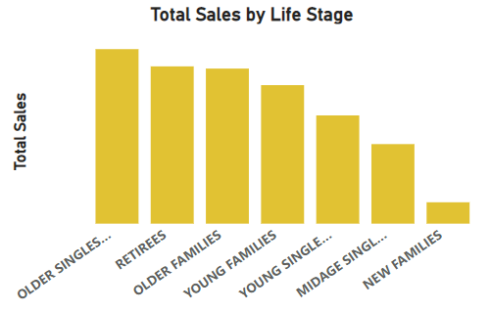
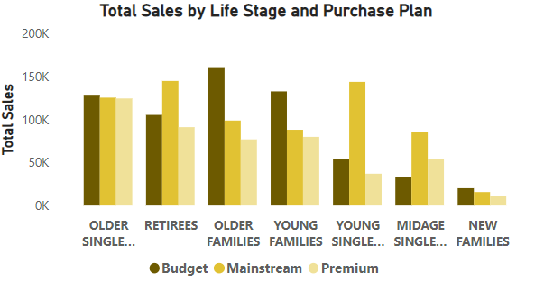
Findings and Insights
Chart 1
Chart 2
The Chart 1 above shows the group of customers that purchase most chips are the 'OLDER SINGLES/COUPLES' and least is 'NEW FAMILIES' based on both Total sales.
Chart 2 shows the drill down of each customer group by Purchase Plan- This consolidates the Sales Drivers of how most sales is coming from the 'OLDER SINGLES/COUPLES' and the least sales is coming from 'NEW FAMILIES’. Both use the Budget Plan the most.

Slide 4
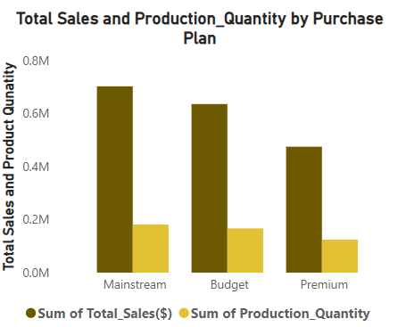
Findings and Insights
To further understand, the break down of sales by sales drivers, we can see from the chart that a large percentage of the customers use the 'Mainstream' Plan followed by the Budget Plan, which makes sense because the ‘OLDER SINGLES/COUPLES’, comprise about 21% of sales while the remaining 79% is coming from others.

Slide 5
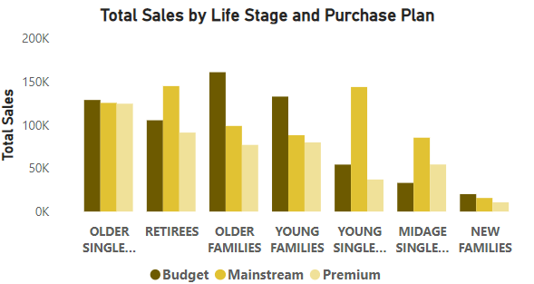
Findings and Insights
Drilling down to 'OLDER SINGLES/COUPLES' & 'NEW FAMILIES'- we can see that they both subscribe more to the 'Budget' Purchase plan.
But focus will be on -'OLDER SINGLES/COUPLES'- because it brings in the most sales.
Since ‘OLDER SINGLES/COUPLES’ have about 21% of sales share of the total sales, then we can recommend the Budget
And also Mainstream plan because it has the highest sales for all the customers as well.
So focus should be on the two.

Slide 6
Findings and Insights
Further Insights;
Upon checking Brand and Packet Size, I deduced that all three Purchase plan have the same features in them based on the packet size and Brand, so conclusion can be draw on whether it is because of the benefits of a purchase plan that is why is most popular.
I will further go to check the range of unit price for the chips, conclusion on that was also inconclusive.
While for the average sales by each purchase plan; I was able to see that the Budget Plan has the least average total sales, which could be the reason it is targeted.

Slide 7
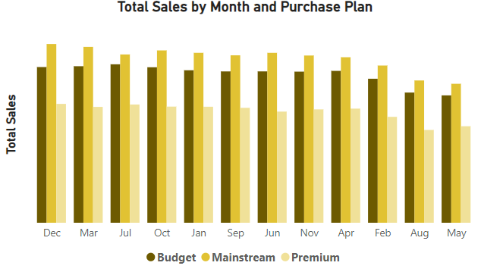
Findings and Insights
From here we can observe that dec has the best sales from the previous year, breaking it down by Purchase plan, shows Mainstream is still in lead across the half year of the previous year and the first half of the most recent date. This shows that sales categorized by Purchase Plan is not driven by season of the year.

Slide 8
Findings and Insights
In Conclusion;
I was able to see that 'OLDER SINGLES/COUPLES' have the highest sales using the 'Budget' plan and the Lifestage with the least sales is 'NEW FAMILIES' with the same plan.
The highest Purchase Plan used generally is the 'Mainstream'
Budget Plan has the lowest Average sales with a small margin even though it has the highest minimum sales.
We can say that that Budget plans gives the most packet friendly offer.
Drilling down to the monthly sales, in the second plot- we can see that from the top 6 and others, 'Mainstream' followed by 'Budget' are highest plan used.
From this we can not really draw why Customers choose a certain Purchase Plan more Information is needed.
From the analysis above, since we don't know the reason for Purchase Plan, I'll give a recommendation based on my findings.

Slide 9
Recommendation
More data on how to understand Customer behaviour is needed.
The supermarket’s strategic plan for the chip category in the next half year should consider the Life stage-'OLDER SINGLES/COUPLES’ category of buying, since it records the best sales in previous years.
More campaigns should be pushed at Customers with plans of expanding the budget plan for that customer segment.
In general Campaigns should also be pushed to encourage Mainstream plans for the next half of year because it is the most popular among the customers.

Slide 10
Task 2
Project Goal:
To test the impact of the new trial layouts by examining the performance in trial vs control stores

Slide 11
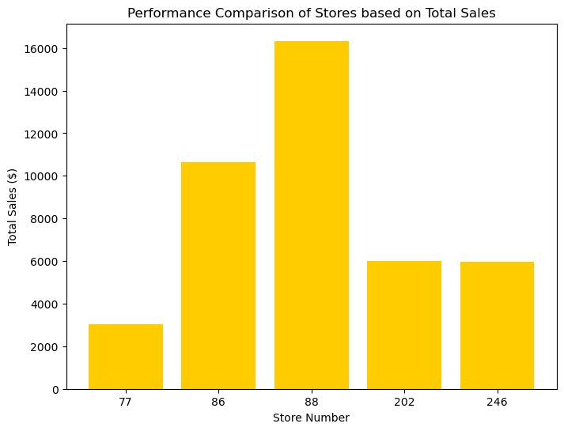
Findings and Insights
Control stores are- 202 and 246.
From the chat, we can conclude that the trial store are doing well than our control stores.

Slide 12
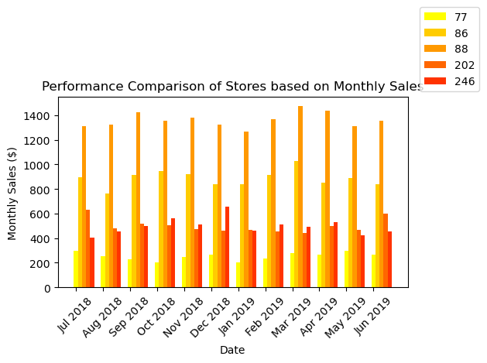
Findings and Insights
Based on monthly sales the trial store that seems not be meeting up is store 77

Slide 13
Recommendation
In conclusion, we can deduce that the trial stores are a good way to test impact on the market.
I recommend that the new trial layout should be rolled out to all stores

